Slide 1

IEEE International Conference on Acoustics, Speech, and Signal Processing
Multiview Depth Map Enhancement by
Variational Bayes Inference Estimation of Dirichlet Mixture Models
Pravin Kumar Rana, Zhanyu Ma, Jalil Taghia, and Markus Flierl
School of Electrical Engineering
KTH Royal Institute of Technology
Stockholm, Sweden
May 31, 2013

Slide 2
Motivation and background

Slide 3
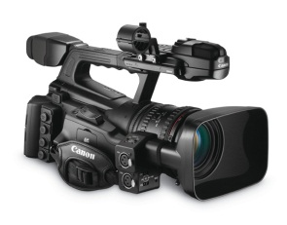
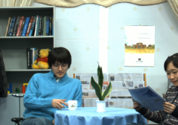
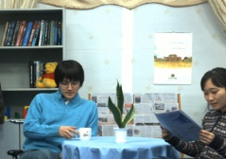
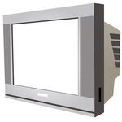

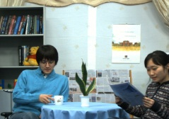
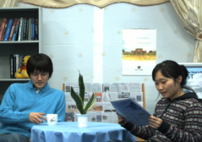
Free-viewpoint television
User | Display
Multiview video imagery
1

Slide 4
Free-viewpoint television
User | Display
Multiview video imagery
1

Slide 5
Free-viewpoint television
User | Display
Multiview video imagery
1

Slide 6
Free-viewpoint television
User | Display
Multiview video imagery
1

Slide 7
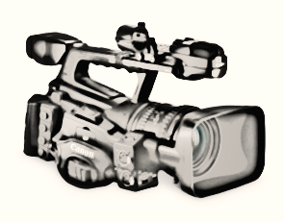
Free-viewpoint television
User | Display
Virtual camera | Virtual view
Multiview video imagery
1

Slide 8
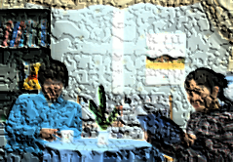
Depth image based rendering
Virtual camera | Virtual view
Multiview video imagery
2

Slide 9
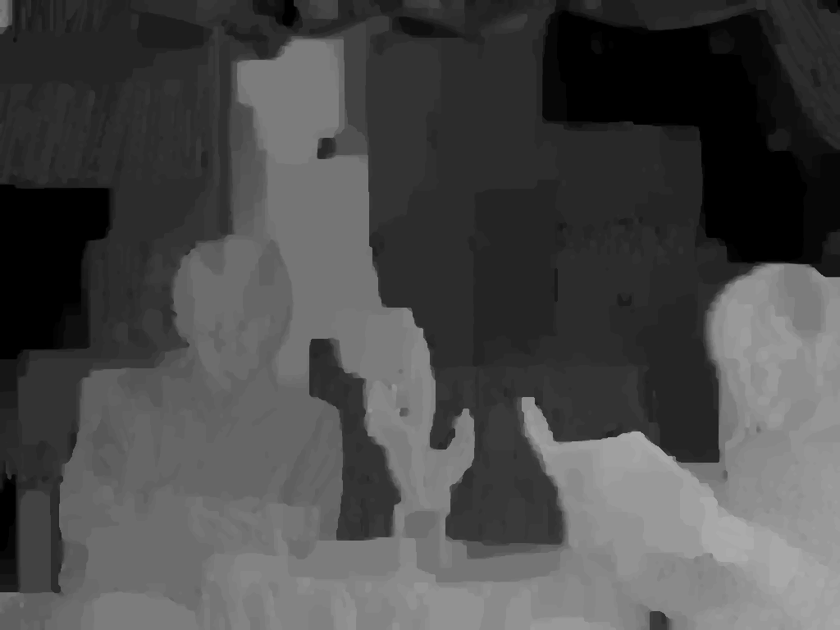
Depth image based rendering
Depth pixels represent shortest distance between object points and the camera plane
To be estimated from multiview imagery
Depth image
Near
3D warping
Far
Virtual camera | Virtual view
Multiview video imagery
2

Slide 10

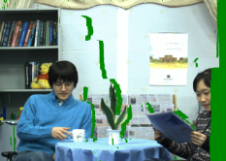

Depth image based rendering
Depth pixels represent shortest distance between object points and the camera plane
To be estimated from multiview imagery
Depth image
Near
3D warping
Far
Virtual camera | Virtual view
Multiview video imagery
2

Slide 11

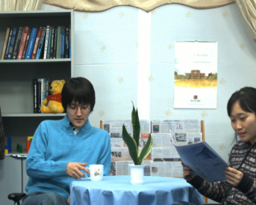

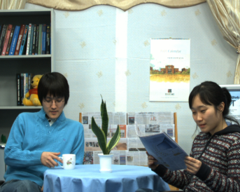
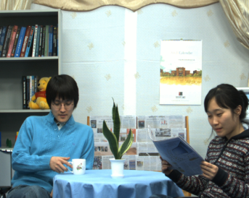

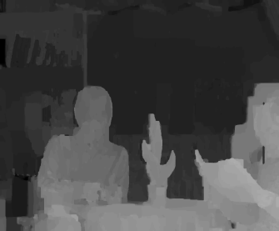
Depth estimation
MPEG Depth Estimation Reference Software (DERS)
View (n-2) | View (n-1) | View (n) | View (n+1) | View (n+2) | View (n+3)
DERS
View (n-2) | View (n-1) | View (n) | View (n+1)
Note: we assume a 1D-parallel camera arrangement
3

Slide 12
Depth estimation
MPEG Depth Estimation Reference Software (DERS)
View (n-2) | View (n-1) | View (n) | View (n+1) | View (n+2) | View (n+3)
DERS
DERS
Estimated depth maps
View (n-2) | View (n-1) | View (n) | View (n+1) | View (n+2) | View (n+3)
Note: we assume a 1D-parallel camera arrangement
3

Slide 13
Depth estimation
MPEG Depth Estimation Reference Software (DERS)
View (n-2) | View (n-1) | View (n) | View (n+1) | View (n+2) | View (n+3)
DERS
DERS
Estimated depth maps
View (n-2) | View (n-1) | View (n) | View (n+1) | View (n+2) | View (n+3)
Note: we assume a 1D-parallel camera arrangement
3

Slide 14
Depth estimation
MPEG Depth Estimation Reference Software (DERS)
View (n-2) | View (n-1) | View (n) | View (n+1) | View (n+2) | View (n+3)
DERS
DERS
Estimated depth maps
View (n-2) | View (n-1) | View (n) | View (n+1) | View (n+2) | View (n+3)
Problem: Inter-view depth inconsistency
Note: we assume a 1D-parallel camera arrangement
3

Slide 15
Depth enhancement framework

Slide 16
Overview of our prior work
Multiview imagery
Concatenation of view imagery
Multiview color classification
Multiview depth classification
Multiview depth subclassification
Enhanced multiview depth maps
[1] P. K. Rana, J. Taghia, and M. Flierl, “A variational Bayesian inference framework for multiview depth image enhancement,” IEEE Int. Symp. Multimedia (ISM), 2012
4

Slide 17
Overview of our prior work
Multiview imagery
Concatenation of view imagery
Color
Classification
Multiview color classification
Multiview depth classification
Multiview depth subclassification
Enhanced multiview depth maps
[1] P. K. Rana, J. Taghia, and M. Flierl, “A variational Bayesian inference framework for multiview depth image enhancement,” IEEE Int. Symp. Multimedia (ISM), 2012
4

Slide 18
Overview of our prior work
Multiview imagery
Concatenation of view imagery
Color
Classification
Multiview color classification
Multiview depth classification
Depth
Classification
Multiview depth subclassification
Enhanced multiview depth maps
[1] P. K. Rana, J. Taghia, and M. Flierl, “A variational Bayesian inference framework for multiview depth image enhancement,” IEEE Int. Symp. Multimedia (ISM), 2012
4

Slide 19
Improved depth enhancement framework

Slide 20
Improved depth enhancement framework
Multiview imagery
Concatenation of view imagery
Gaussian mixture
model
Multiview color classification
Multiview depth classification
K-means
Multiview depth subclassification
Enhanced multiview depth maps
[1] P. K. Rana, J. Taghia, and M. Flierl, “A variational Bayesian inference framework for multiview depth image enhancement,” IEEE Int. Symp. Multimedia (ISM), 2012
5

Slide 21
Improved depth enhancement framework
Multiview imagery
Concatenation of view imagery
Gaussian mixture
model
Multiview color classification
Dirichlet mixture
model
Multiview depth classification
K-means
Multiview depth subclassification
Mean-shift
Enhanced multiview depth maps
[1] P. K. Rana, J. Taghia, and M. Flierl, “A variational Bayesian inference framework for multiview depth image enhancement,” IEEE Int. Symp. Multimedia (ISM), 2012
5

Slide 22
Concatenation of view imagery
Multiview imagery has inherent inter-view similarity
To have a unique model for multiview imagery
The inherent inter-view similarity is exploited by concatenating views from multiple viewpoints
View (n-1) | View (n) | View (n+1) | View (n+2)
View (n-1) | View (n) | View (n+1) | View (n+2)
6

Slide 23
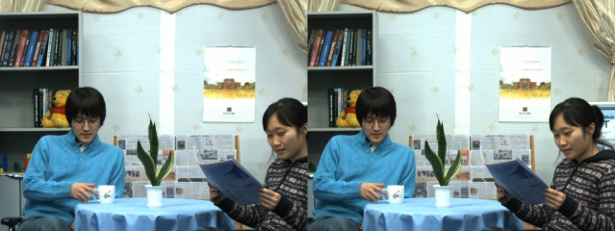
Multiview color classification
Color space
View (n) | View (n+1)
…
…
RGB
[1] P. K. Rana, J. Taghia, and M. Flierl, “A variational Bayesian inference framework for multiview depth image enhancement,” IEEE Int. Symp. Multimedia (ISM), 2012
7

Slide 24
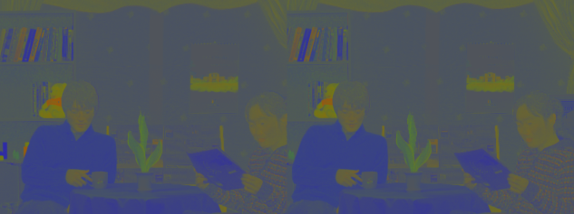
Multiview color classification
Color space
View (n) | View (n+1)
View (n) | View (n+1)
…
…
…
…
RGB xyz
Use the chromatic color representation to make the procedure insensitive to the absolut luminance
The chromaticity of a pixel is described by a vector of three chromaticity coefﬁcients [x y z]^{T}
x+y+z = 1
[1] P. K. Rana, J. Taghia, and M. Flierl, “A variational Bayesian inference framework for multiview depth image enhancement,” IEEE Int. Symp. Multimedia (ISM), 2012
7

Slide 25
Multiview color classification
Why variational Bayes inference (VBI)?
The goal of classification is to partition an image into regions each of which has a reasonably homogeneous visual appearance
Usually, clustering algorithm, such as expectation-maximization (EM) suffers from one major drawbacks that the number of clusters has to be known
Variational Bayes inference automatically select the number of cluster
[2] C. M. Bishop, Pattern Recognition and Machine Learning, 1st ed. New York: Springer, 2006.
8

Slide 26
Multiview color classification
Why Dirichlet mixture model with variational Bayes inference?
The vector of image pixels has nonnegative elements and is bounded
It can be efﬁciently modeled by utilizing non-Gaussian distributions [3]
Based on the pixel vector’s properties, assume that the pixel vectors of each cluster are Dirichlet distributed
Use Dirichlet mixture model (DMM) with VBI to capture the all underlying clusters in multiview imagery
It reduces complexity
[3] Z. Ma, P. K. Rana, J. Taghia, M. Flierl, and A. Leijon, “Bayesian estimation of Dirichlet mixture model with variational inference,” IEEE Trans. PAMI, submitted, 2013.
9

Slide 27

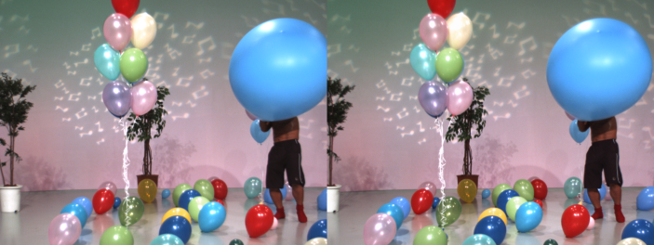
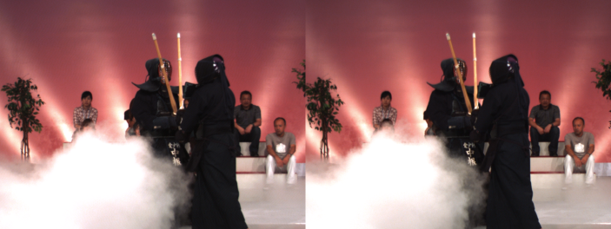
Multiview color classification
Newspaper Balloons Kendo
Input multiview data
10

Slide 28
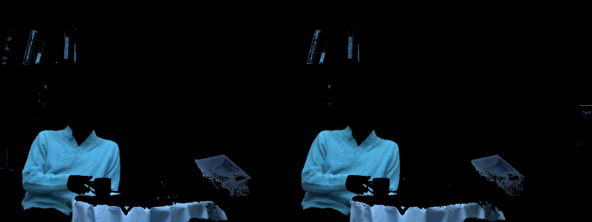
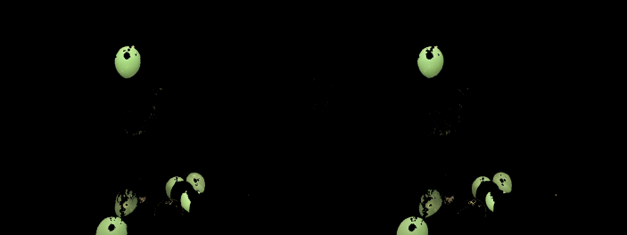
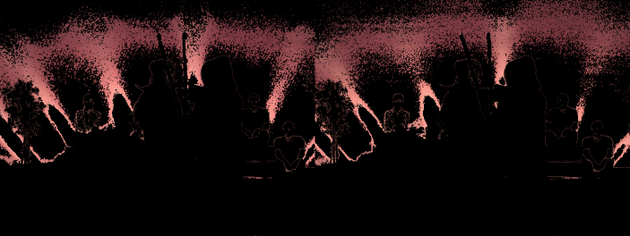
Multiview color classification
Newspaper Balloons Kendo
Input multiview data
Using Dirichlet mixture model with variational Bayes inference
10

Slide 29

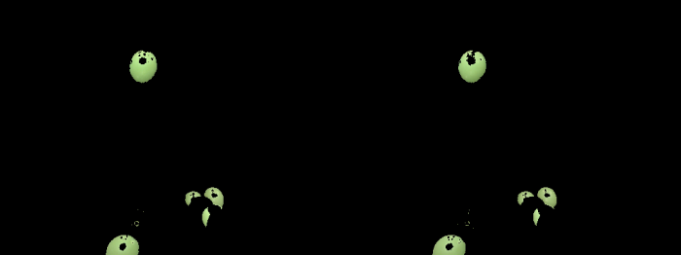
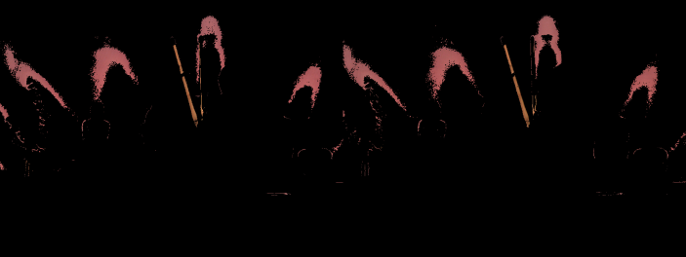
Multiview color classification
Newspaper Balloons Kendo
Input multiview data
Using Dirichlet mixture model with variational Bayes inference
Using Gaussian mixture model with variational Bayes inference
10

Slide 30
Multiview color classification
Newspaper Balloons Kendo
Input multiview data
Using Dirichlet mixture model with variational Bayes inference
Using Gaussian mixture model with variational Bayes inference
10

Slide 31
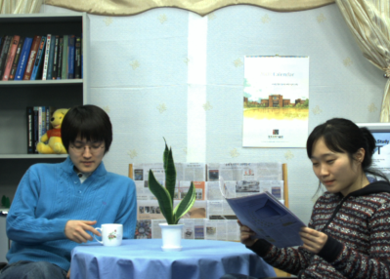
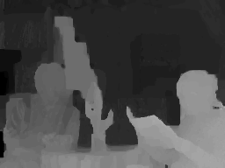
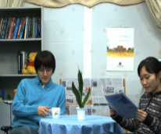
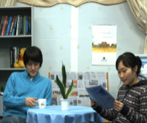
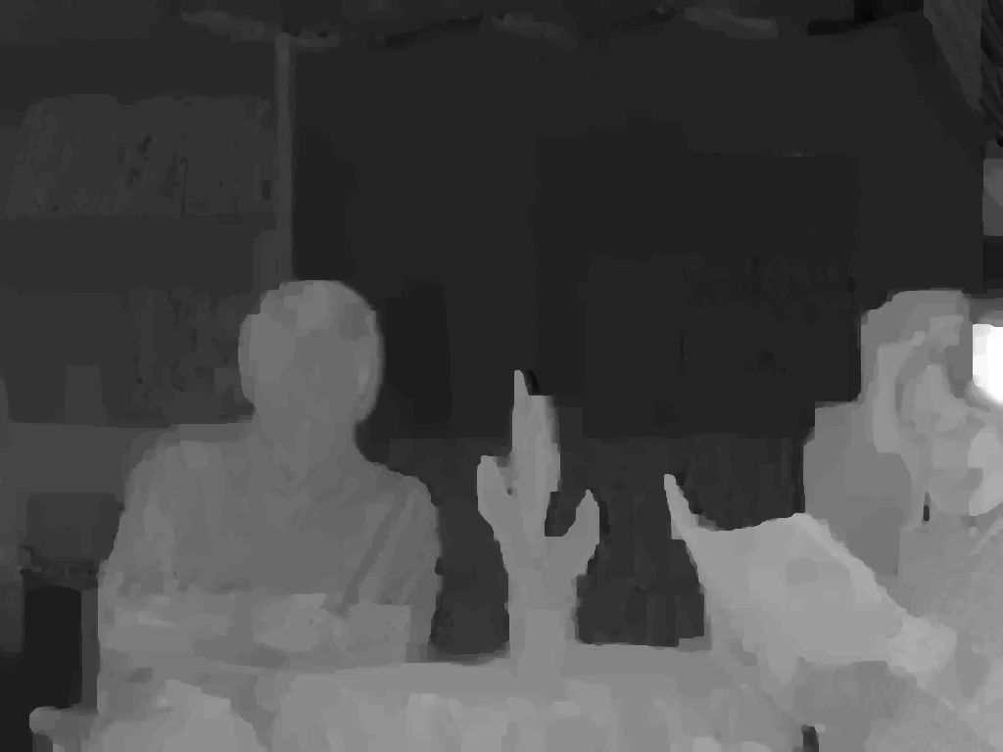

Multiview depth classification
Exploiting the per-pixel association between color and depth
View image | Depth image
Concatenated view imagery | Concatenated depth imagery
11

Slide 32
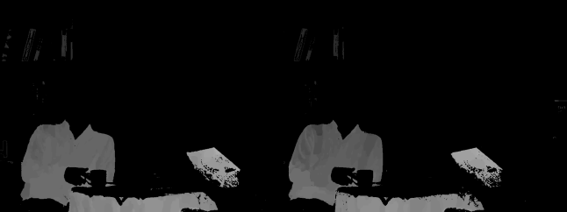
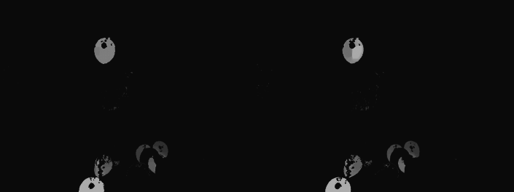
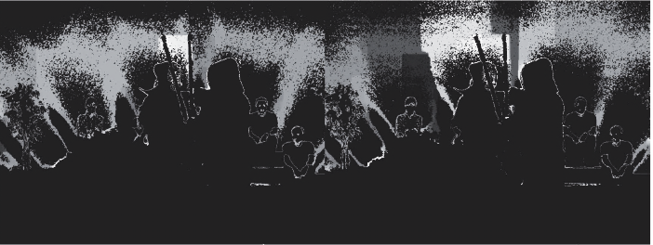
Multiview depth classification
Newspaper Balloons Kendo
Input multiview data
Using Dirichlet mixture model with variational Bayes inference in xyz space
12

Slide 33
Multiview depth classification
Newspaper Balloons Kendo
Input multiview data
Using Dirichlet mixture model with variational Bayes inference in xyz space
12

Slide 34
Multiview depth subclassification
Difference between color and depth clusters
Members have similar colors
pixels
Members may have different
depth values
Why?
due to foreground and background depth difference
due to inter-view inconsistency
13
Notes:
The members of a cluster are similar colors, whereas members of the corresponding depth cluster are different depth values.
Inter-view depth inconsistency : If an object point with a given color is visible from N viewpoints, this point should have the same depth value in all N depth maps.
However, such points usually have different depth values in the depth cluster due to the inconsistency across multiple viewpoints.

Slide 35
Multiview depth subclassification
Means-shift clustering
A nonparametric clustering technique
Does not require prior knowledge of the number of clusters
Does not constrain the shape of the clusters
Assigns the mean to depth pixels irrespective of the originating viewpoints
Bayesian approaches imply higher computational complexity
14
Notes:
The members of a cluster are similar colors, whereas members of the corresponding depth cluster are different depth values.
Inter-view depth inconsistency : If an object point with a given color is visible from N viewpoints, this point should have the same depth value in all N depth maps.
However, such points usually have different depth values in the depth cluster due to the inconsistency across multiple viewpoints.

Slide 36
Experimental results

Slide 37


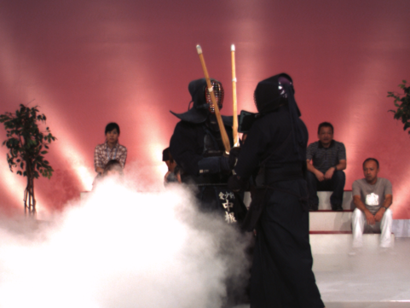
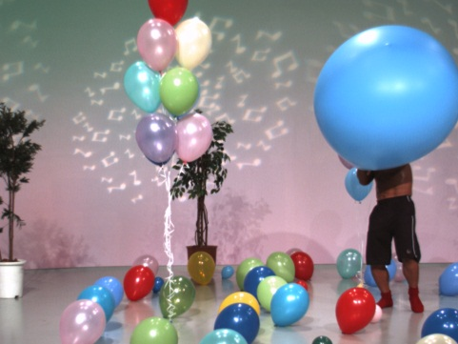
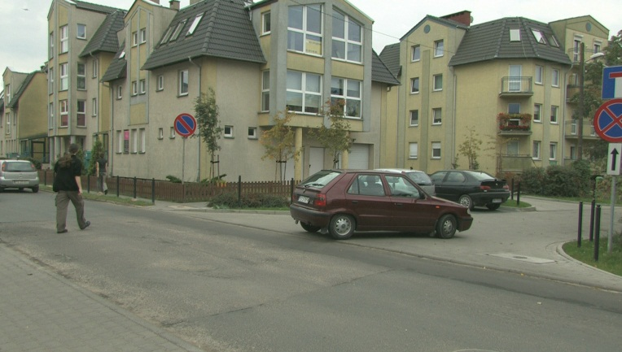
Experimental setup
MPEG 3DTV multiview data set
Newspaper
(1024 X 768)
Lovebird1
(1024 X 768)
Kendo
(1024 X 768)
Balloons
(1024 X 768)
Poznan street
(1920 X 1088)
15

Slide 38
Complexity
Multiview data set | Initial number of mixture components | Active number of mixture components (after convergence)
 |  | VBI-GMM | VBI-DMM
Lovebird1 | 100 | 31 | 24
Kendo | 100 | 34 | 15
16

Slide 39
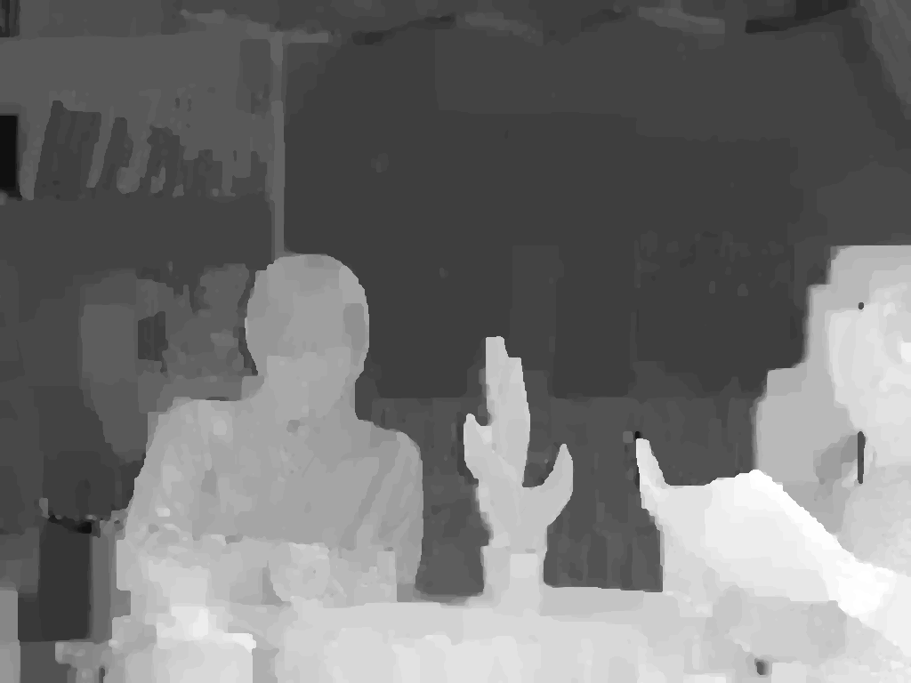
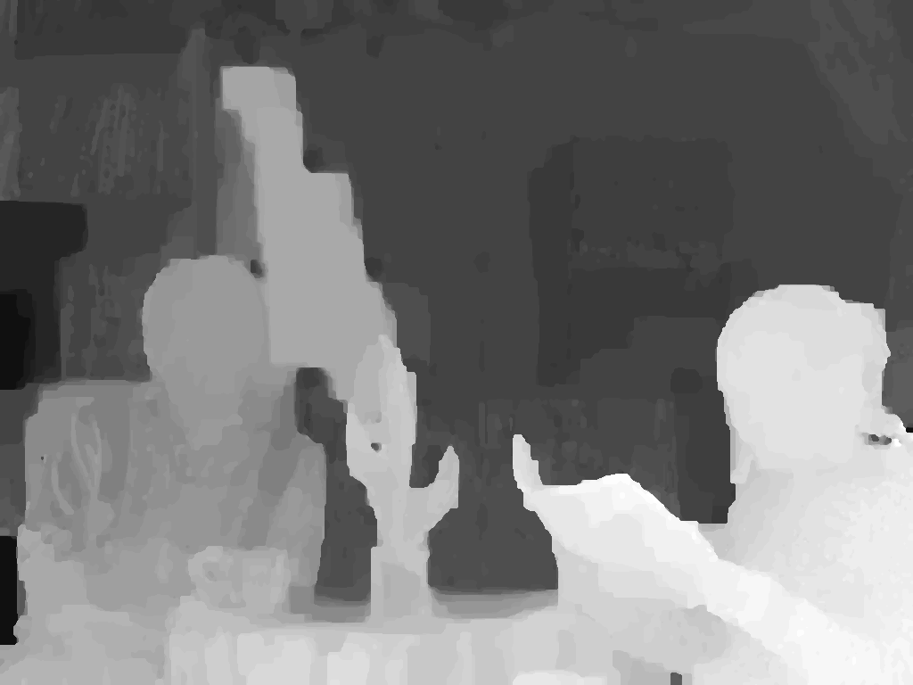
Depth image based rendering
MPEG View Synthesis Reference Software (VSRS) 3.5
Enhanced depth map
Left
Enhanced depth map
Right
17

Slide 40
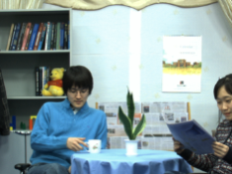

Depth image based rendering
MPEG View Synthesis Reference Software (VSRS) 3.5
Enhanced depth map
Left
Reference view
Enhanced depth map
Right
Reference view
17

Slide 41

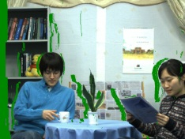
Depth image based rendering
MPEG View Synthesis Reference Software (VSRS) 3.5
Enhanced depth map
Warped view
3D warping
Left
Reference view
Enhanced depth map
3D warping
Right
Warped view
Reference view
17

Slide 42
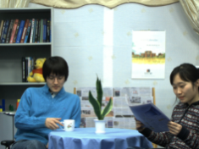
Depth image based rendering
MPEG View Synthesis Reference Software (VSRS) 3.5
Enhanced depth map
Warped view
3D warping
Left
Reference view
Hole filling & inpainting
Enhanced depth map
Virtual intermediate
view
3D warping
Right
Warped view
Reference view
17

Slide 43

Depth image based rendering
MPEG View Synthesis Reference Software (VSRS) 3.5
Enhanced depth map
Warped view
3D warping
Left
Reference view
Hole filling & inpainting
Enhanced depth map
Virtual intermediate
view
3D warping
Right
Warped view
Reference view
Original camera view
17

Slide 44
Depth image based rendering
MPEG View Synthesis Reference Software (VSRS) 3.5
Enhanced depth map
Warped view
3D warping
Left
Y-PSNR (dB)
Reference view
Hole filling & inpainting
Enhanced depth map
Virtual intermediate
view
3D warping
Right
Warped view
Reference view
Original camera view
17

Slide 45
Objective results
Test sequence | Input view pair | Virtual view | Y-PSNR [dB]
 |  |  | With MPEG depth maps | With VBIGMM + K-Means depth maps | With VBIDMM + Mean-shift depth maps
Newspaper | (4, 6) | 5 | 32.00 | 32.10 | 32.11
Kendo | (3, 5) | 4 | 36.54 | 36.72 | 39.35
Lovebird1 | (6, 8) | 7 | 28.50 | 28.68 | 29.04
Balloons | (3, 5) | 4 | 35.69 | 35.93 | 36.02
Poznan Street | (3, 5) | 4 | 35.56 | 35.58 | 35.72
K-means sub-clustering
Number of cluster : 12
17

Slide 46
Objective results
Test sequence | Input view pair | Virtual view | Y-PSNR [dB]
 |  |  | With MPEG depth maps | With VBIGMM + K-Means depth maps | With VBIDMM + Mean-shift depth maps
Newspaper | (4, 6) | 5 | 32.00 | 32.10 | 32.11
Kendo | (3, 5) | 4 | 36.54 | 36.72 | 39.35
Lovebird1 | (6, 8) | 7 | 28.50 | 28.68 | 29.04
Balloons | (3, 5) | 4 | 35.69 | 35.93 | 36.02
Poznan Street | (3, 5) | 4 | 35.56 | 35.58 | 35.72
K-means sub-clustering
Number of cluster : 12
17

Slide 47
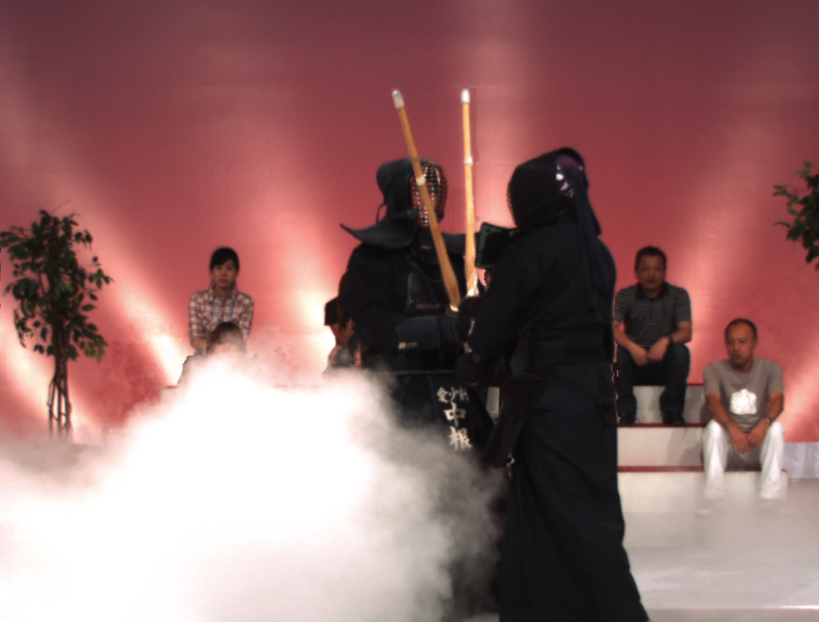
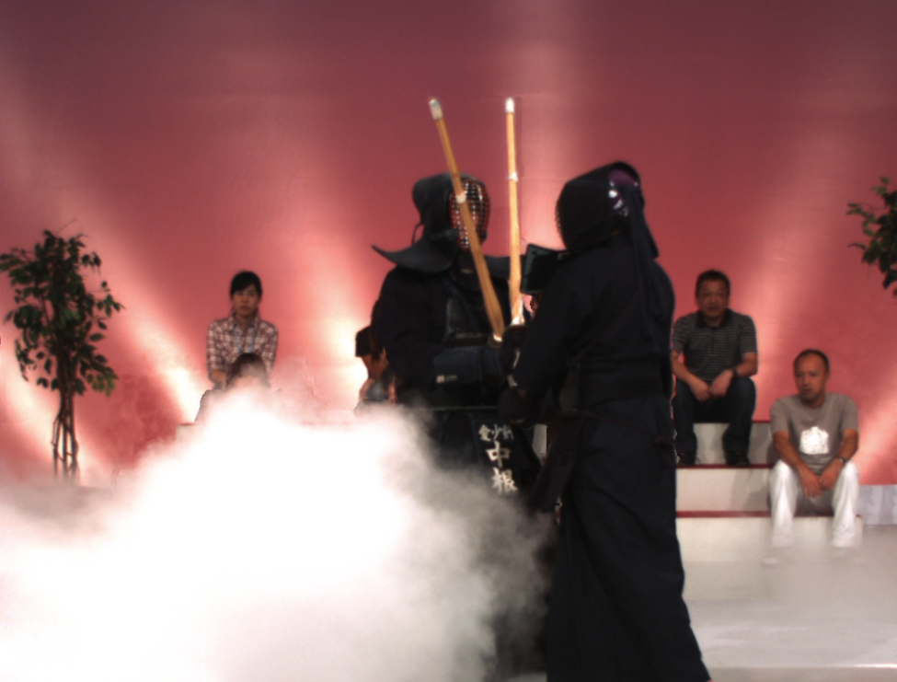
Subjective results
Test sequence: Kendo
With MPEG depth map
With VBDMM Mean-shift depth map
18

Slide 48
Subjective results
Test sequence: Kendo
With MPEG depth map
With VBDMM Mean-shift depth map
18

Slide 49




Subjective results
Test sequence: Kendo
Original
With MPEG depth maps
With VBGMM + K-Means
depth maps
With VBDMM + Mean-Shift
depth maps
18

Slide 50
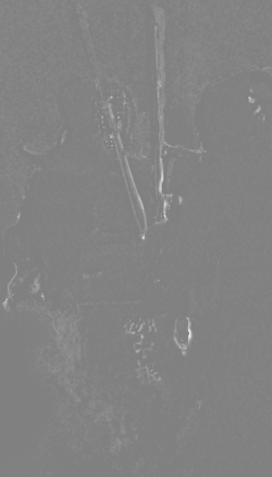
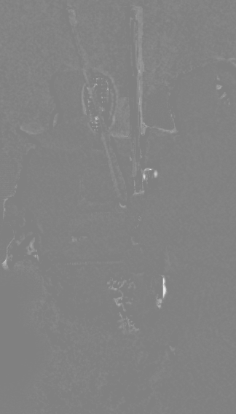
Subjective results
Test sequence: Kendo
With VBGMM K-Means
depth maps
With VBDMM Mean-Shift
depth maps
18

Slide 51


Subjective results
Test sequence: Lovebird 1
With MPEG depth map
With VBDMM Mean-shift depth map
19

Slide 52
Subjective results
Test sequence: Lovebird 1
With MPEG depth map
With VBDMM Mean-shift depth map
19

Slide 53
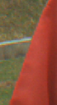
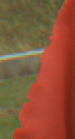
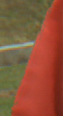
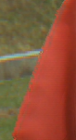
Subjective results
Test sequence: Lovebird 1
Original
With MPEG depth maps
With VBGMM K-Means
depth maps
With VBDMM Mean-Shift
depth maps
19

Slide 54
Subjective results
Test sequence: Lovebird 1
With MPEG depth map
With VBDMM Mean-shift depth map
19

Slide 55

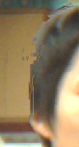


Subjective results
Test sequence: Lovebird 1
Original
With MPEG depth maps
With VBGMM K-Means
depth maps
With VBDMM Mean-Shift
depth maps
19

Slide 56
Conclusions
The inter-view depth consistency and hence, the free-viewpoint experience improve
The per-pixel association between depth and color is exploited by classification
Depth subclassification improves depth maps and hence, view rendering quality
Both objective and subjective results improve
20

Slide 57
Thank you

